Slide 1

Indoor localization using WIFI fingerprinting
December 18th, 2019
Aniss Nigro

Slide 2
Objectives
Identify issues related to indoor localization
Evaluate indoor localization via WIFI fingerprinting
Propose solutions to improve the results and deploy the solution

Slide 3

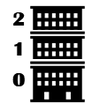

Process to indoor localization via WIFI fingerprinting
Identify the building
using WAPs RSSI
Identify the floor
using WAPs RSSI and Building
Estimate the longitude and latitude
using WAPs RSSI, Building and Floor

Slide 4
Preprocessing
1
2
Review the values in a logical way
The “100” meaning “no signal” should be lower than the ones with signal → Replacing the “100” values into “-110”
An RSSI lower than “-90” is similar to having no signal → Replacing all values < “-90” to “-110”
Removing useless and ambiguous WAPs
WAPs with no variance don’t give us any useful information and should be removed
WAPs that gives us false information should be removed: 248, 113, 114, 186, 187, 180, 181, 189, 46
3
Remove duplicates
Remove the observations that have the exact same values
If an observation has different WAPs signals, keep only one observation with the best RSSI (if a WAP is not detected by one of the observation, replace the value by “-110”)
4
Remove observations with no signal
and the ones that moves
If an observation has no signal, remove it (only for the training dataset)
Comparing Training and Validation datasets, if a WAP is in different buildings, remove it

Slide 5
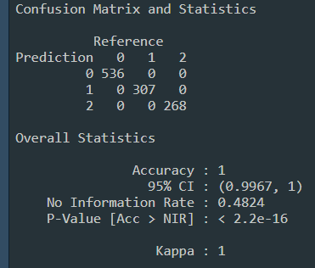
Building detection using WAPs RSSI
For this task, machine learning was not used, a dedicated algorithm was developed.
Creation of a table of WAPs and their according building (based on the number of observations)
For each observation, calculate the ratio of WAPs in building 0, 1 and 2
If one of the ratios is superior than 45% (even distribution of buildings), select the building according to the WAP with the best RSSI
If one of the ratios is less than 45%, select the most represented building according to WAPs
Building detection results on validation dataset

Slide 6
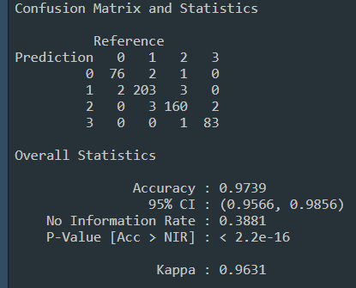
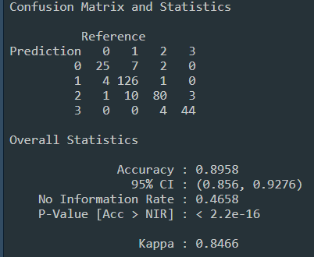
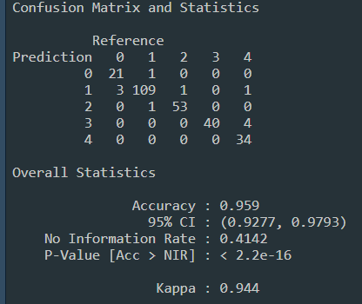
Floor detection using WAPs RSSI and Building
Building 0
Building 1
Building 2
Select only the observation of building 0
Remove WAPs with no variance
Remove ambiguous observations from the training dataset
Train the model (Random Forest)
Apply the model to the validation dataset
Select only the observation of building 1
Remove WAPs with no variance
Remove ambiguous observations from the training dataset
Scale the observation to remove phone bias
Train the model (Random Forest)
Apply the model to the validation dataset
Select only the observation of building 2
Remove WAPs with no variance
Remove ambiguous observations from the training dataset
Scale the observation to remove phone bias
Train the model (Random Forest)
Apply the model to the validation dataset
Floor detection results on validation dataset (B0)
Floor detection results on validation dataset (B1)
Floor detection results on validation dataset (B2)

Slide 7
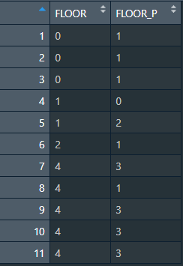
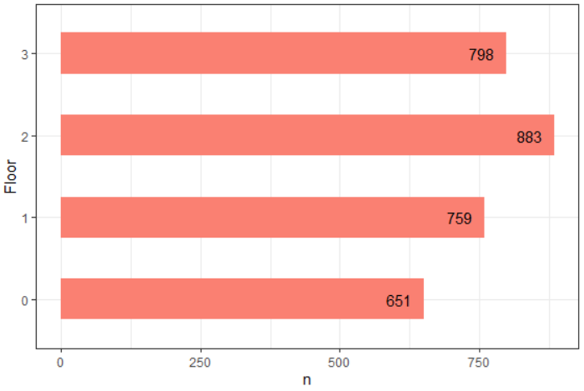
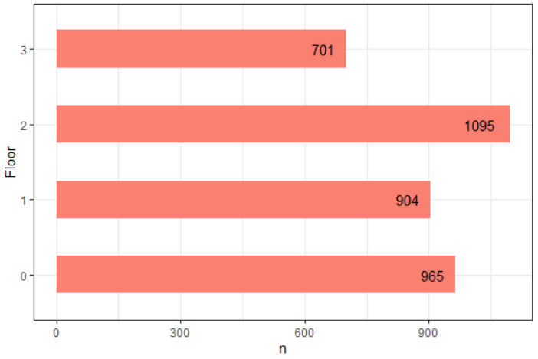
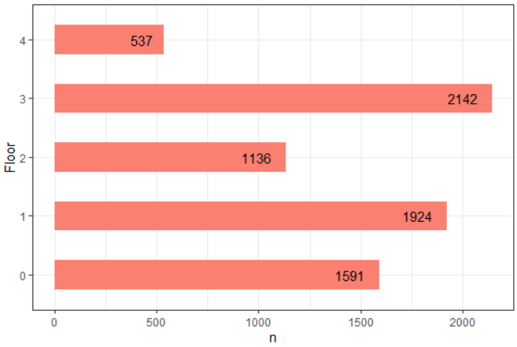
Floor detection using WAPs RSSI and Building – Issues
We can see that main of the errors occurs between adjoining floors (floor 0 predicted as floor 1…). This means that some WAPs from adjoining floors are detected and used to predict the floor which create errors.
B0
We can also see here that the distribution is not even between floors which gives more weight to some floors creating prediction errors
B1
B2 real floors vs predicted floors
Solutions :
For the WAPs that are detected in other floors, we could find material to block signal (too expensive)
For the distribution problem, we can just record more observation to have an even distribution
Another potential problem (to be verified) is mobile WAPs between floors which need to be identified and removed
B2
Distribution of obs per building / floor

Slide 8
Estimation of the longitude and latitude using WAPs RSSI, Building and Floor
Building 0
Building 1
Building 2
Select only the observation of building 0
Remove WAPs with no variance
Scale the observation to remove phone bias
Train the model using Floor (Random Forest – best / KNN)
Apply the model to the validation dataset
Calculate the distance between the real and predicted values
If a distance > 20 is considered as error
Accuracy: 95,5%
Accuracy: 82.1%
Accuracy: 91%
If a distance > 15 is considered as error
Accuracy: 86%
Accuracy: 72%
Accuracy: 72%
These results are not acceptable but they can be improved.
A further analysis has to be done in order to explain those errors. In fact, the bad distribution can be a lead since most of the errors are located in less represented areas.

Slide 9





Deployment into production environment
Prediction system
Training system
<<< WAPs RSSI, Building, Floor, Longitude, Latitude <<<
Trained models
<<< Updates <<<
Model builder
>>> Detected WAPs RSSI >>>
API
Training data
<<< Building, Floor, Longitude, Latitude <<<
User
Data collectors
 | Issues | Potential solutions
1 | The dataset has duplicates, false information and bad distribution | Handle this issues while collecting training data by regularly checking data quality
2 | Some WAPs are being moved regularly | Track those WAPs in order to remove them or to collect a new training data
3 | The global architecture may evolve (new floor, new building) | Anticipate this evolutions by developing a scaling system
4 | Different models may use the same features making the global system heavy and slow | Include modularity while developing in order to reuse some feature (preprocessing…)
5 | The training data and models will be obsolete after some time | Regularly update the training data and models

